Slide 1

Cardiotocography classification
Tesina in: Mathematics in Machine Learning
Professors:
Prof. Mauro GASPARINI
Prof. Francesco VACCARINO
Candidate:
Daniele Giannuzzi

Slide 2
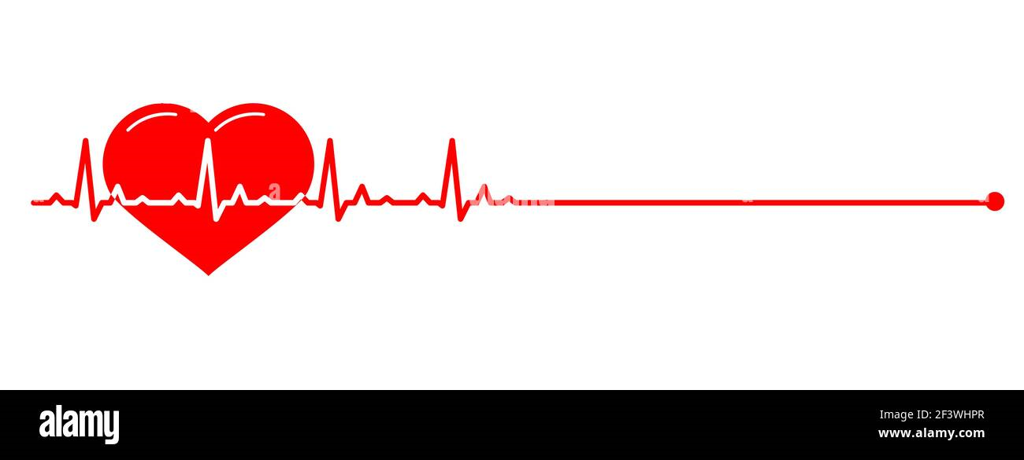

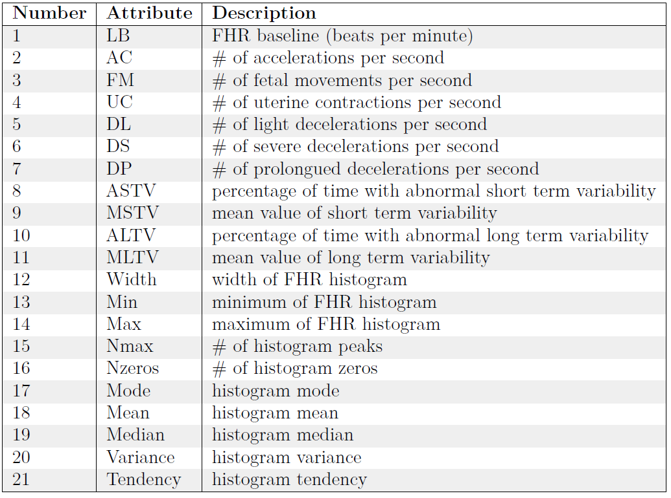
Data overview
Attributes are based on Fetal Heart Rate
Classification of fetal state:
Normal
Anomaly
Dataset composed of:
2126 fetal cardiotocograms
21 real-valued attributes

Slide 3
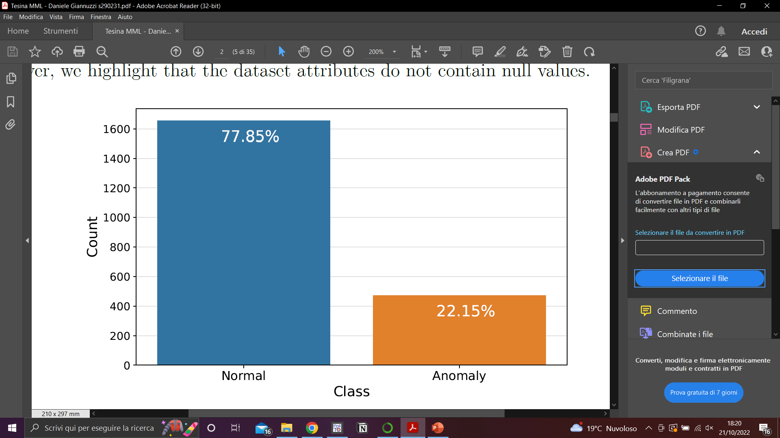
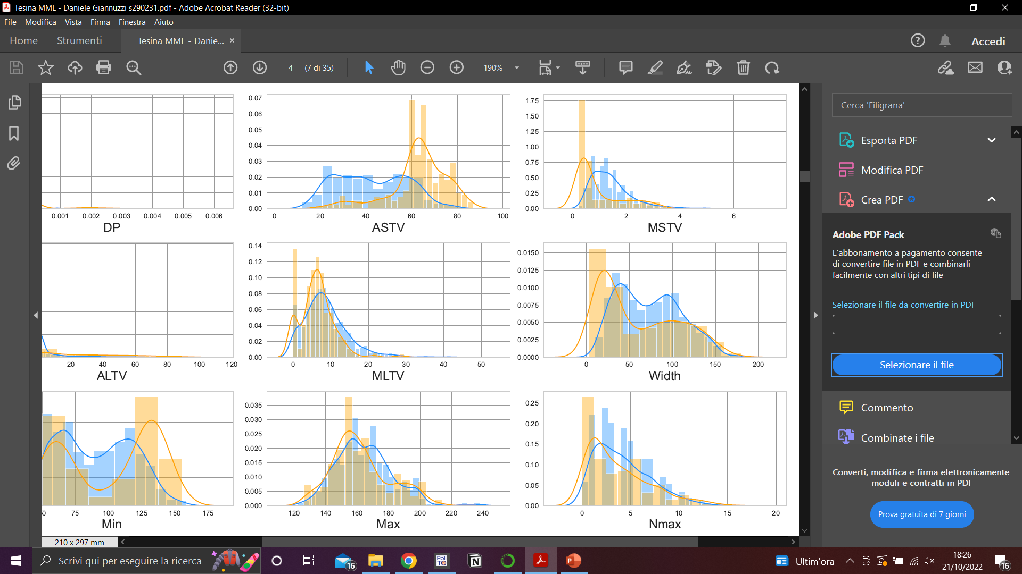
Data exploration
The classes in the dataset are unbalanced
The distribution of the two classes is very different for some attribute

Slide 4
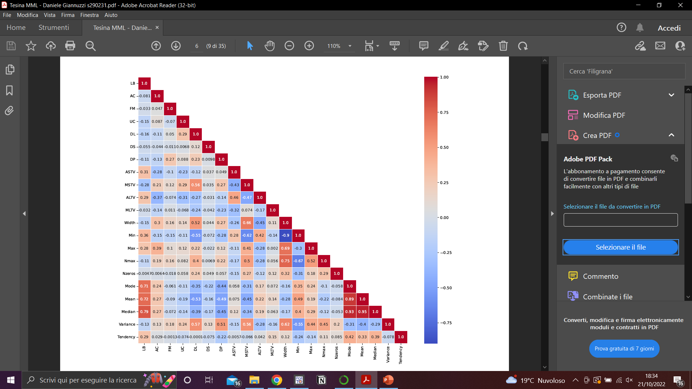
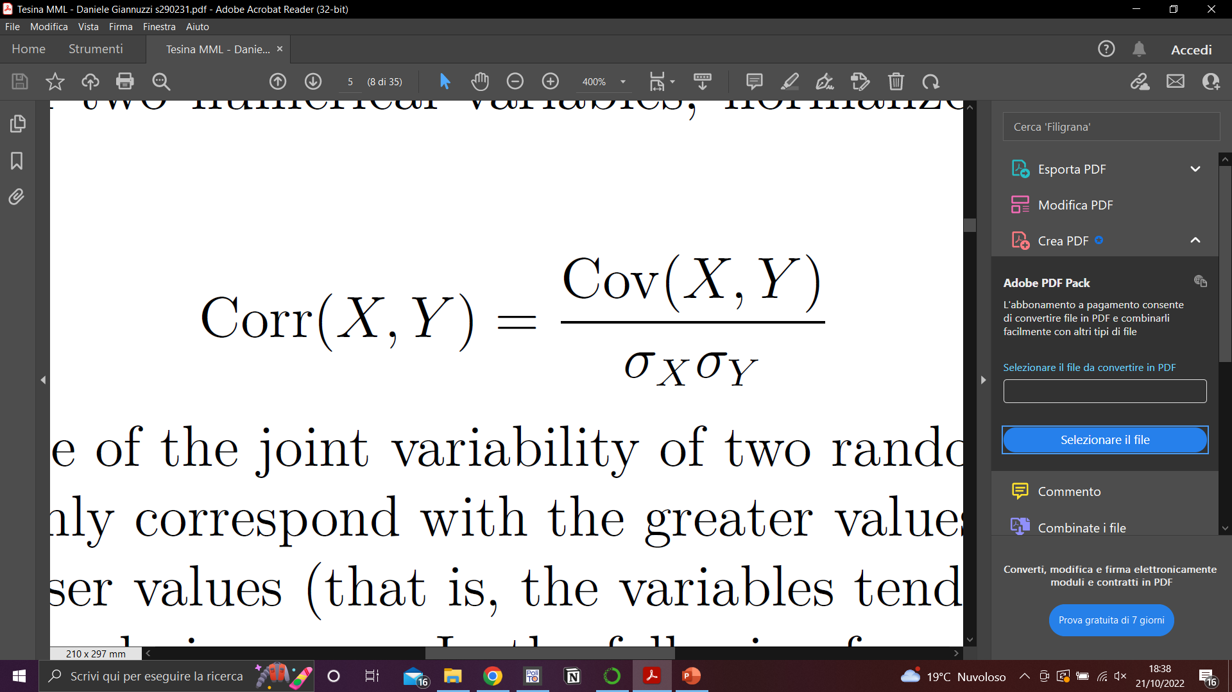
Attributes correlation
Pearson’s correlation coefficient:
measures the linear relationship between a pair of variables, in the range of [-1, 1]
Positive correlation: among Mode, Mean and Median, since all related to the concept of the distribution

Slide 5
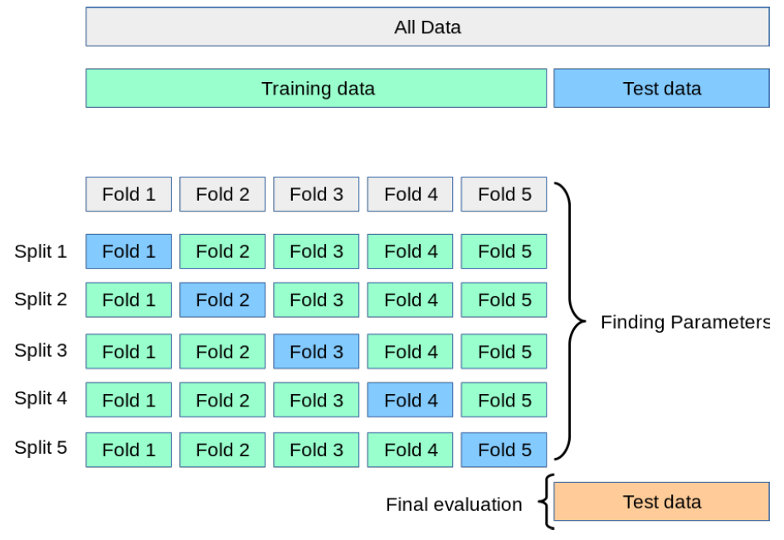
Data splitting
Stratified splitting: 80% of samples for training – 20% of samples for testing
Stratified K-Fold: splitting in training set and validation set (K=5) in order to choose:
preprocessing pipeline
model
model hyperparameters

Slide 6
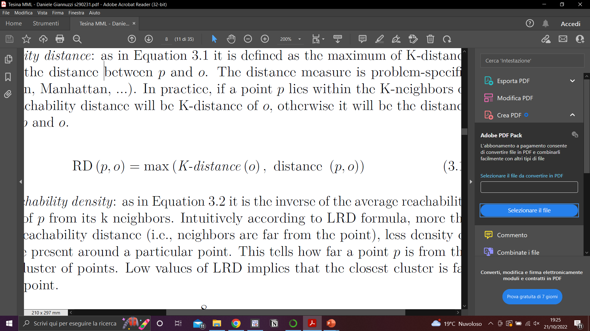
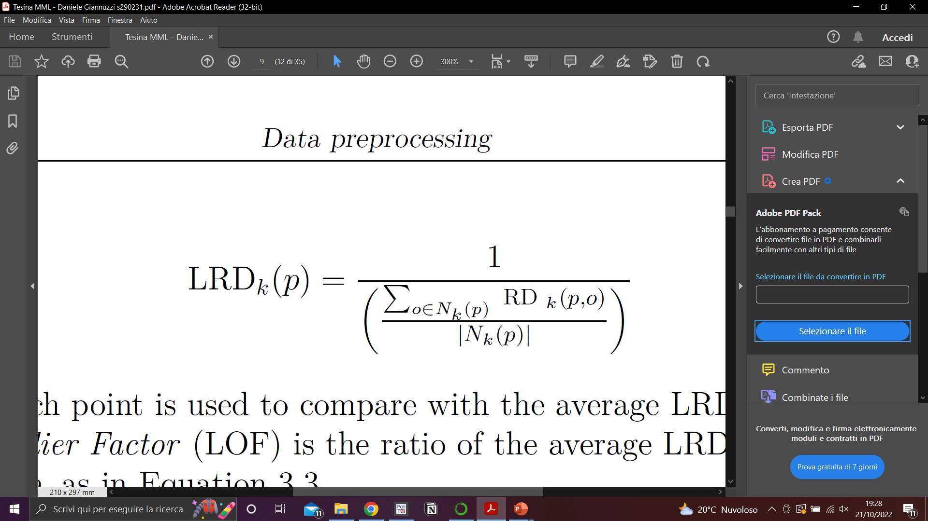
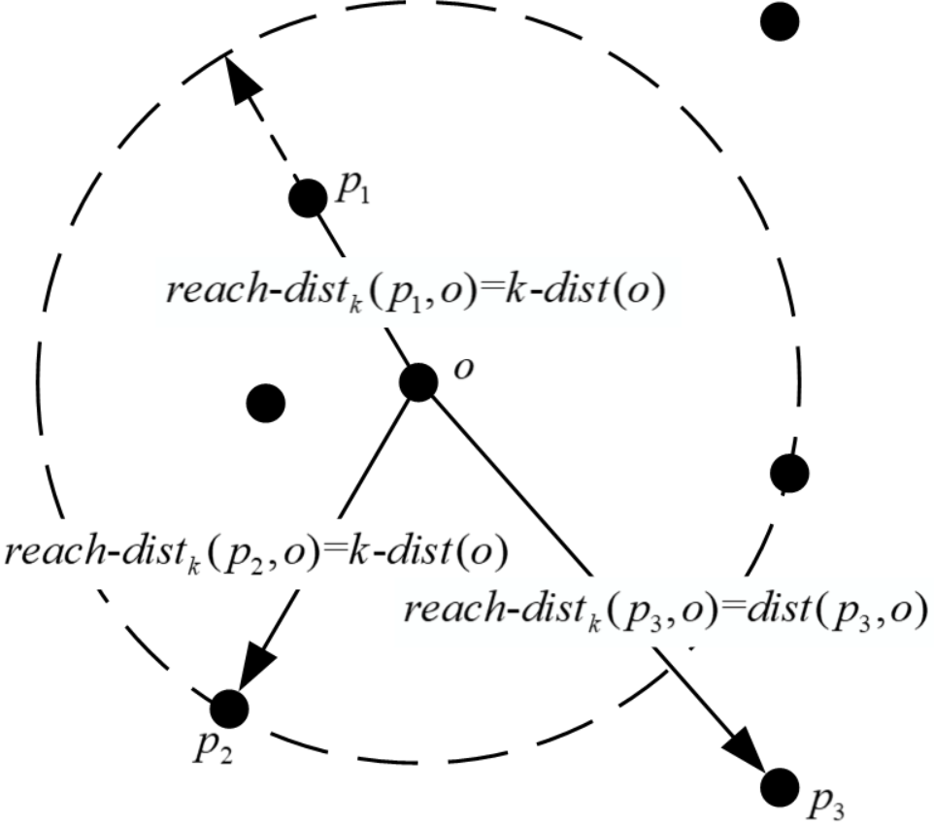
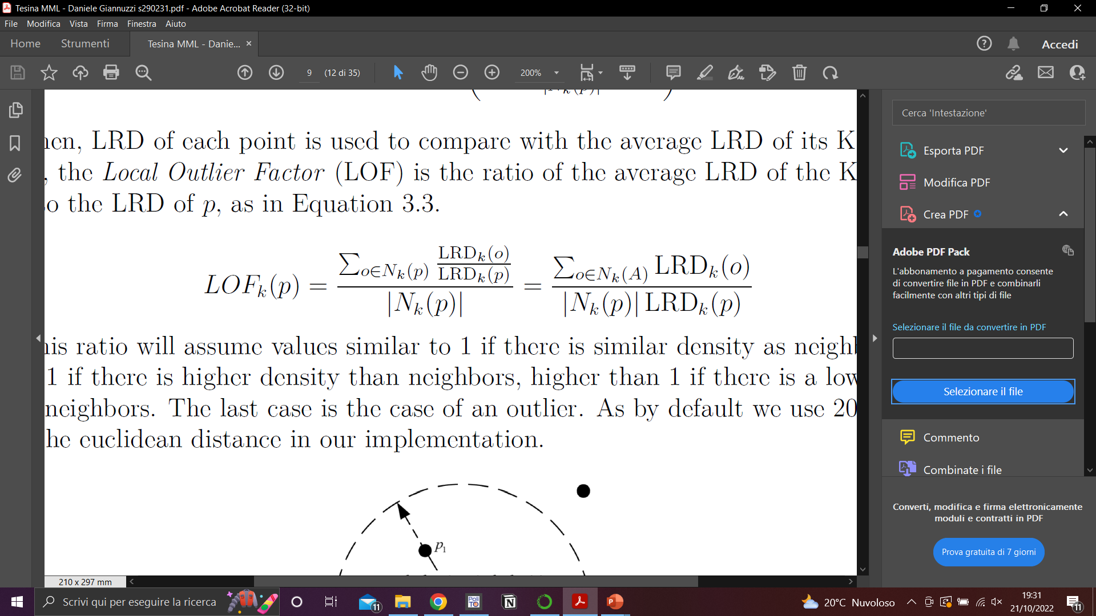
Data cleaning: LOF
Presence of outliers can affect the performance of a machine learning algorithm
LOF: outlier detector that produces a Local Outlier Factor (i.e. anomaly score)
K-distance(p): distance between p and its K^{th} nearest neighbor
K-neighbors(p): N_{k}(p), a set of points that lie in or on the circle of radius K-distance
Reacheability distance:
Local reachability density:
Local Outlier Factor:
If LOF>>1 the point is considered an outlier

Slide 7
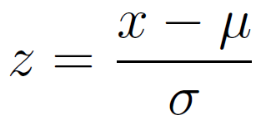
Feature scaling: Standardization
Algorithms that compute the distance between the features are biased towards numerically larger values if the data is not scaled.
Z-score normalization:
Standardization is not affected by outliers as normalization, because there is no predefined range of transformed features

Slide 8
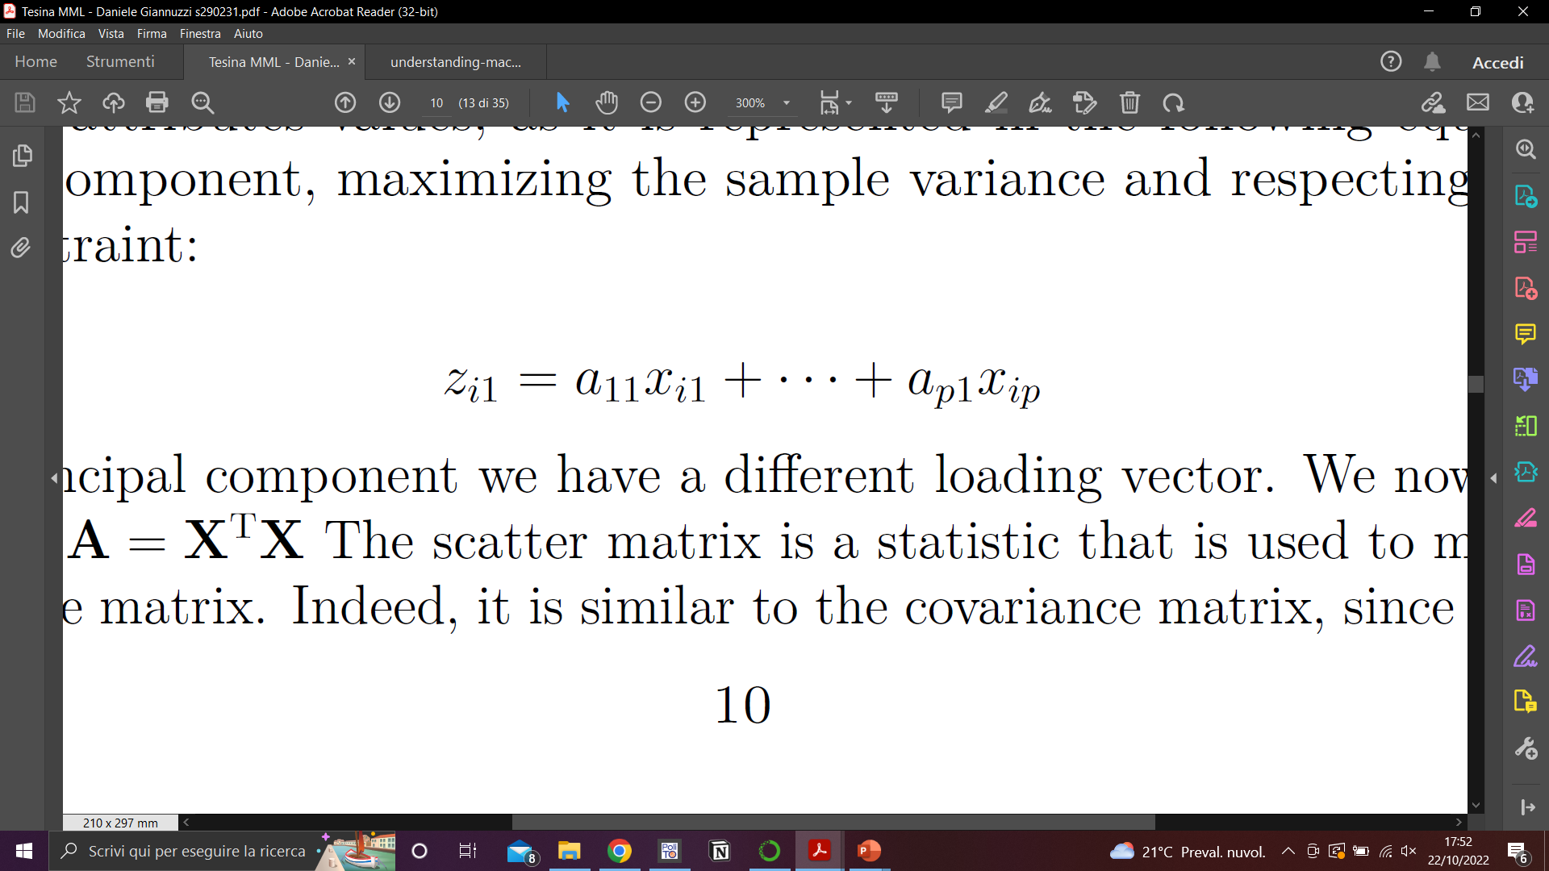
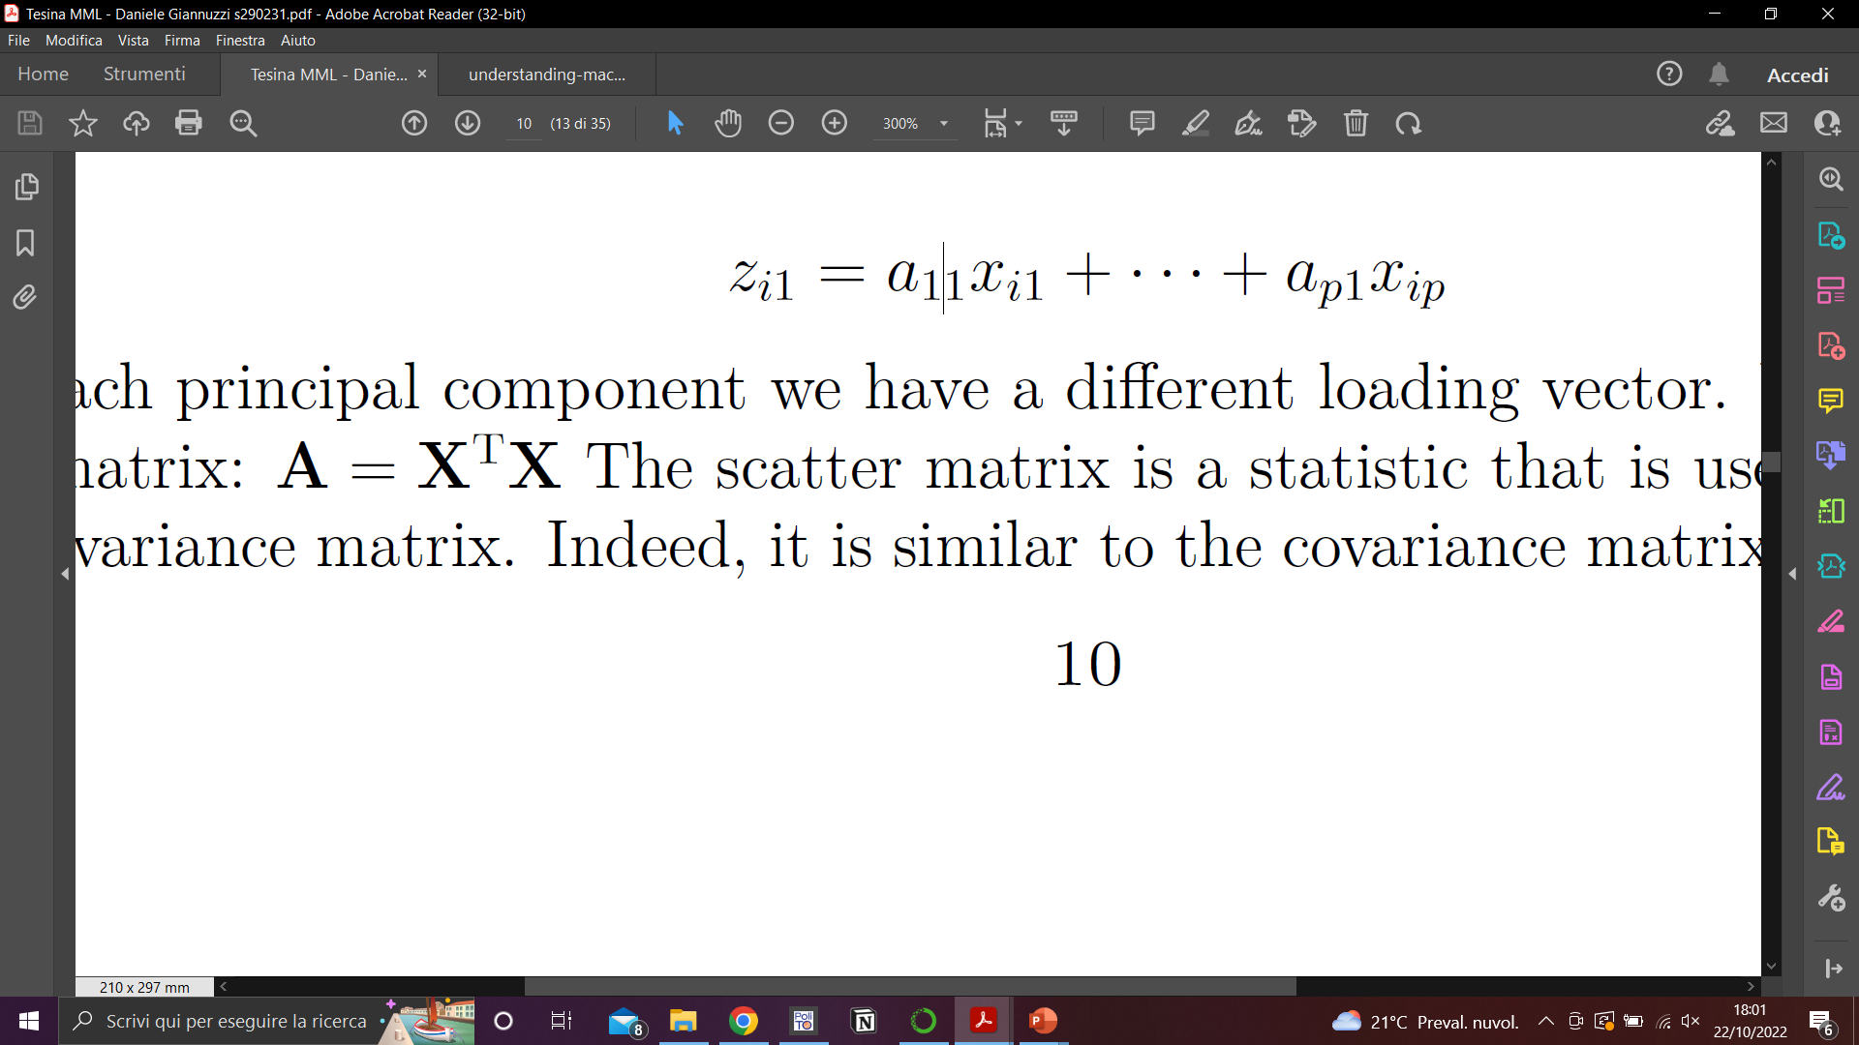
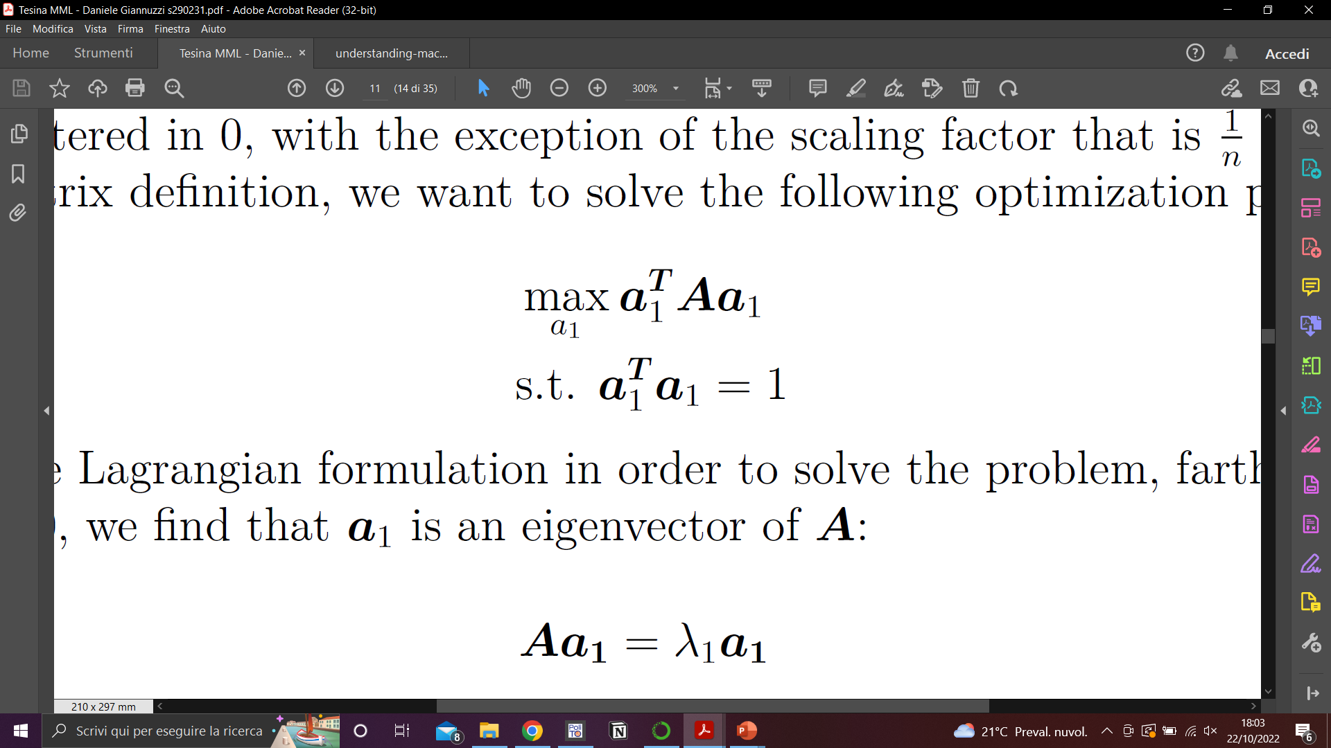
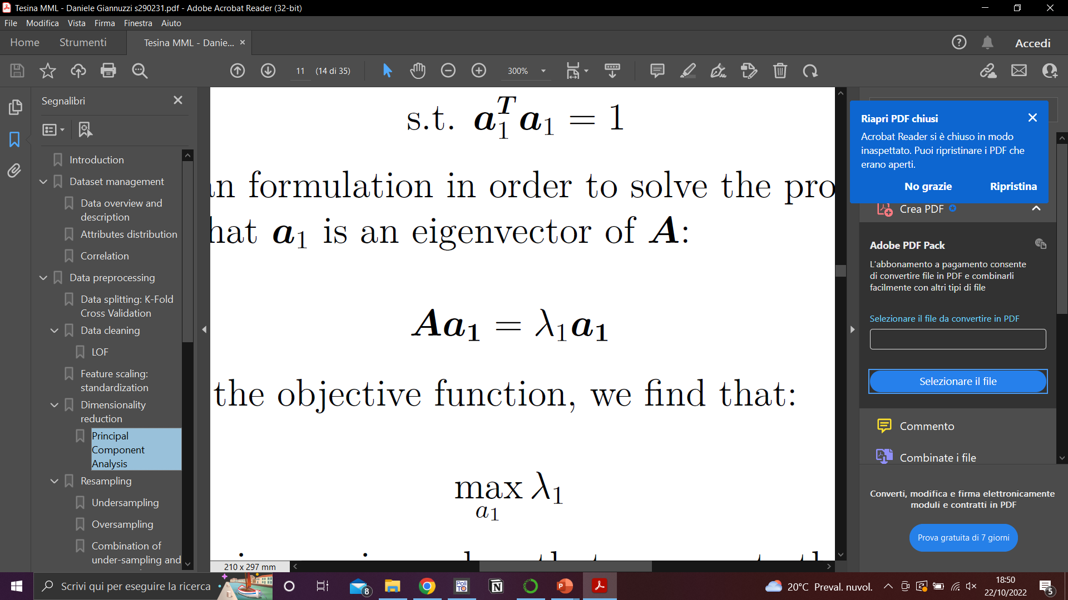
Dimensionality reduction: PCA
Principal Component Analysis: creates fewer (q) uncorrelated representative variables
(principal components) that explain most of the variance in the original set of p features
We search for the linear combination (z) of the sample (i) feature values that has the largest sample variance. In case of the 1st principal component we have:
Given:
Optimization
problem
Solving the
Lagrangian

Slide 9
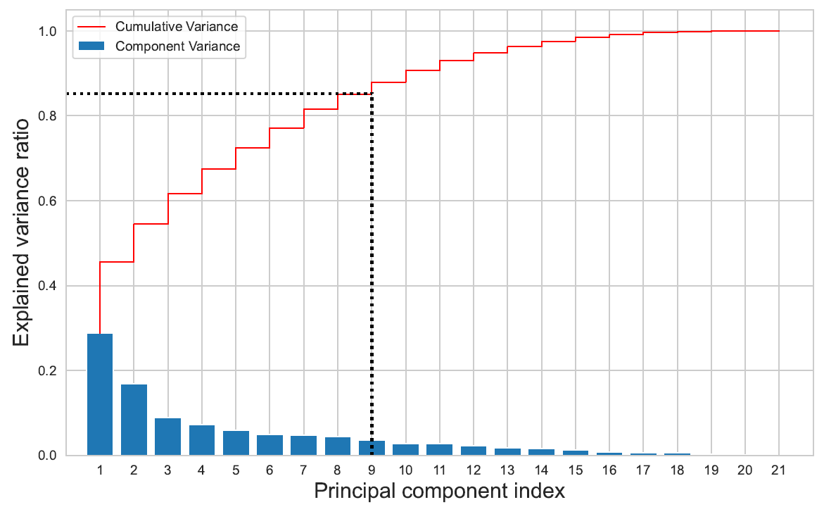
Dimensionality reduction: PCA
The other principal components correspond to analogous optimization problem,
costraining uncorrelation to other principal components.
To find q principal components we take q eigenvectors of A, associated to the greatest eigenvalues

Slide 10

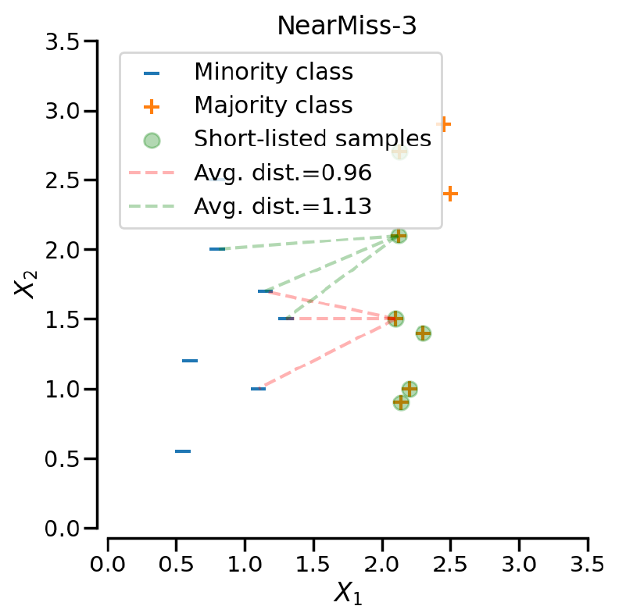
Undersampling: NearMiss-3
Undersampling: discard samples of the majority class
NearMiss-3: is a 2-steps algorithm. First, for each sample of the minority class, their M nearest-neighbors will be kept. Then, the samples of the majority class removed are the one for which the average distance to the N
nearest-neighbors is the largest.

Slide 11
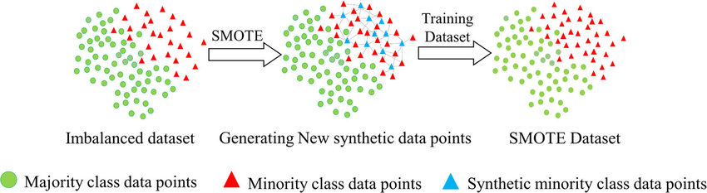
Oversampling: SMOTE
Oversampling: generate new data for the minority classes
Smote: generates syntethic samples selecting a random point along the segment between two minority class samples.

Slide 12
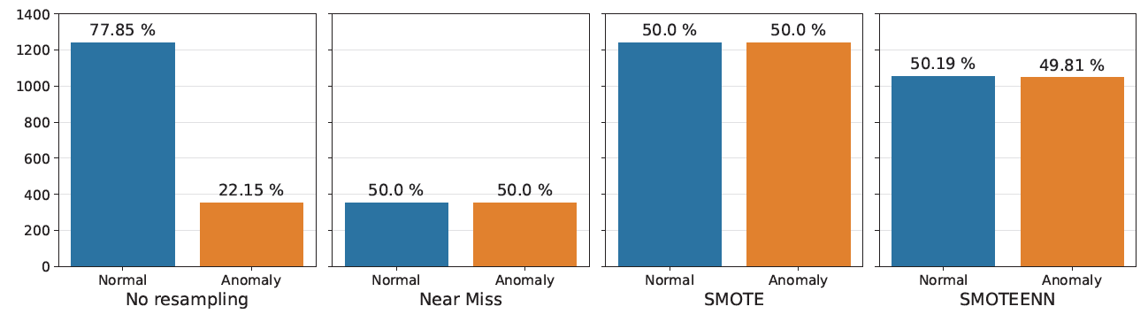
Over and Under-sampling: SMOTEENN
Combination of SMOTE (oversampling) + ENN (undersampling)
removes samples whose class label differs
from a majority of its k nearest neighbors
Comparison of different tehcniques:

Slide 13
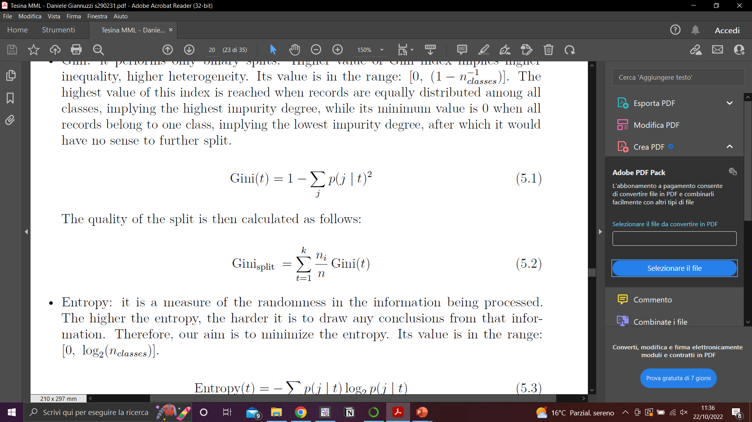
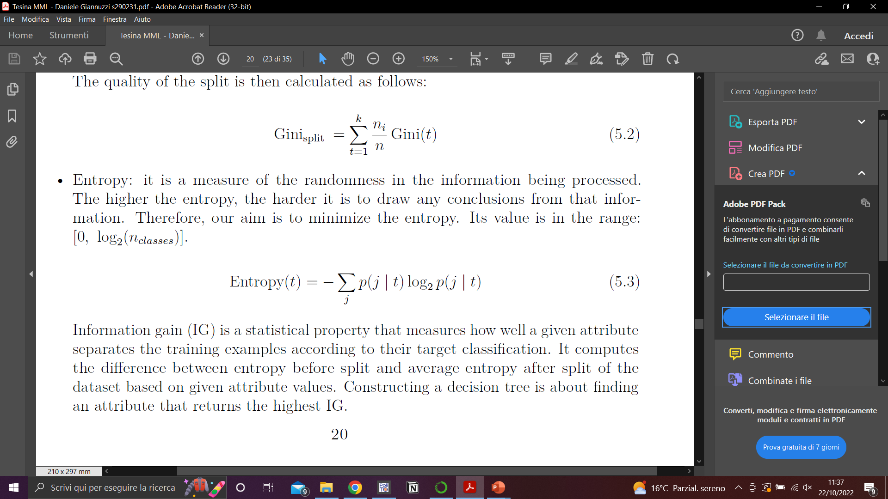
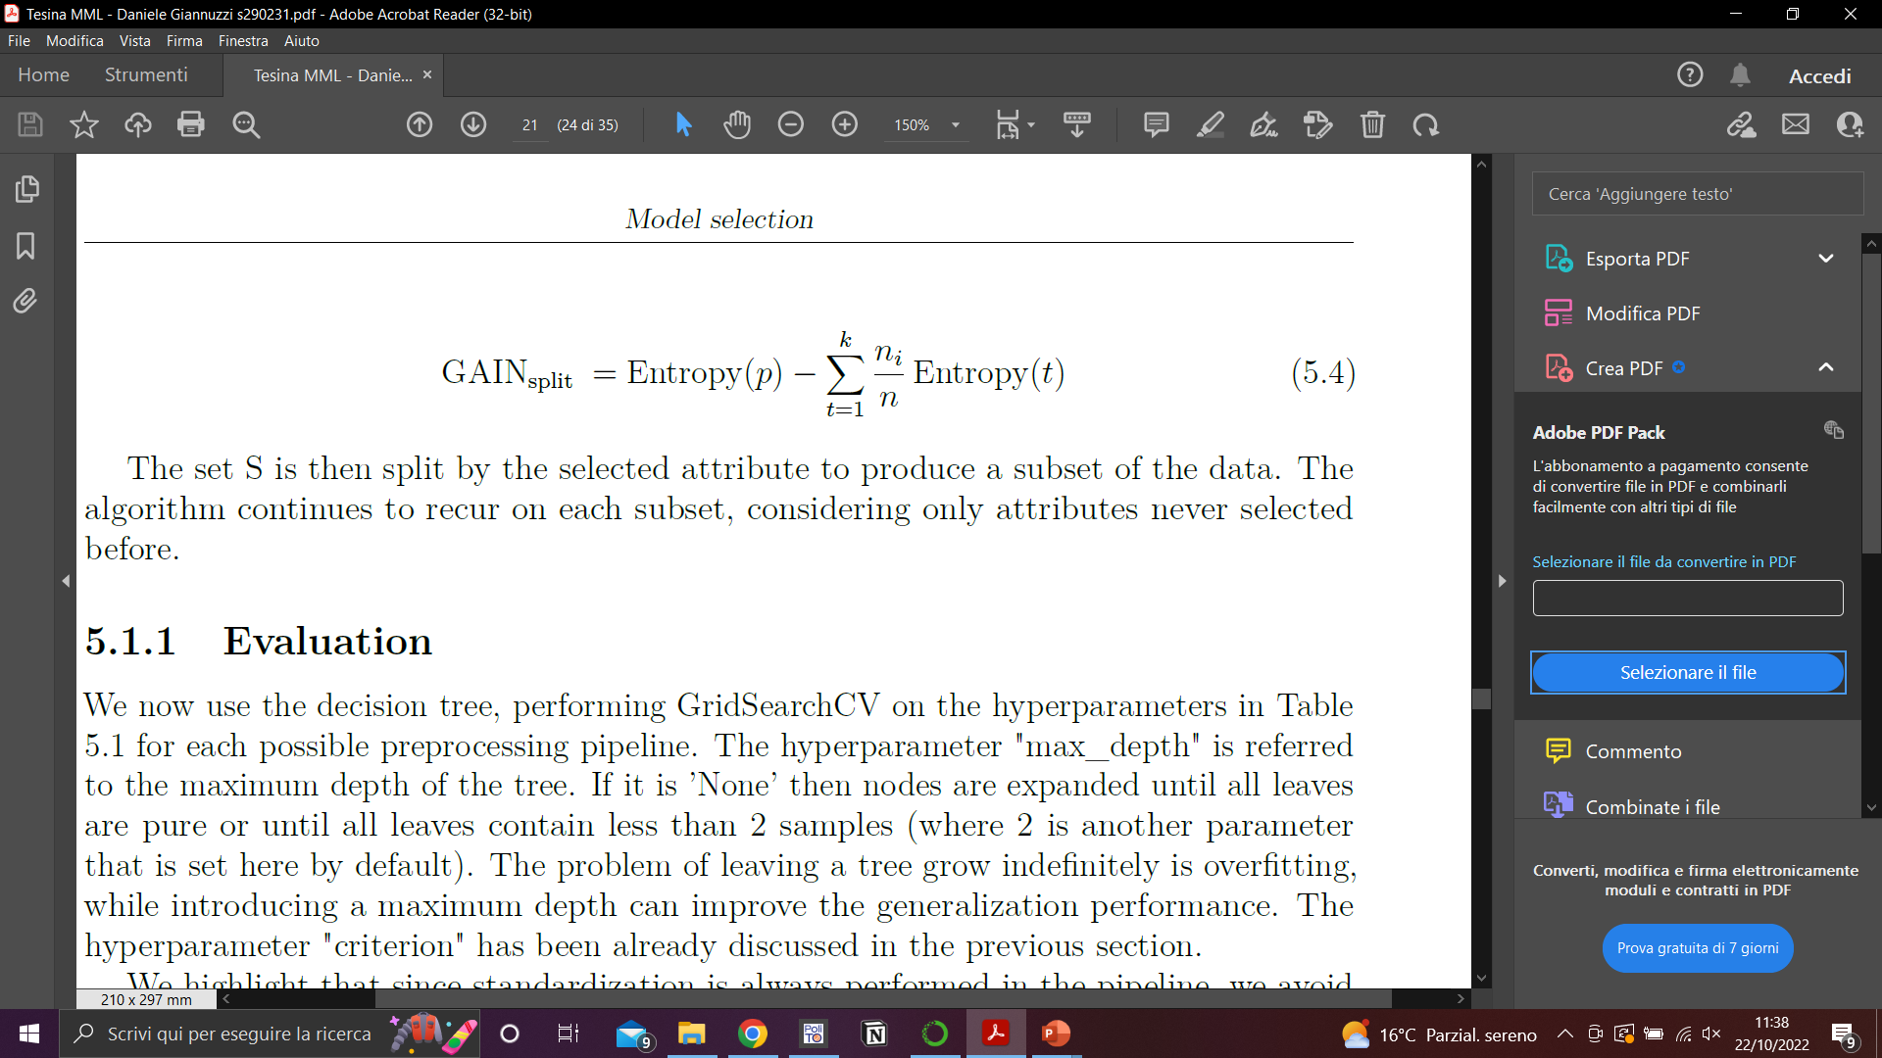
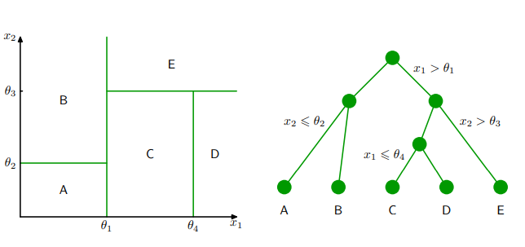
Model: Decision Tree
To build a tree, when splitting a node we can minimize as impurity measures:
Gini index:
Entropy:
assigning to each leaf a label according to a majority vote
We classify an instance x by traveling from a root node to a leaf associated with a label

Slide 14
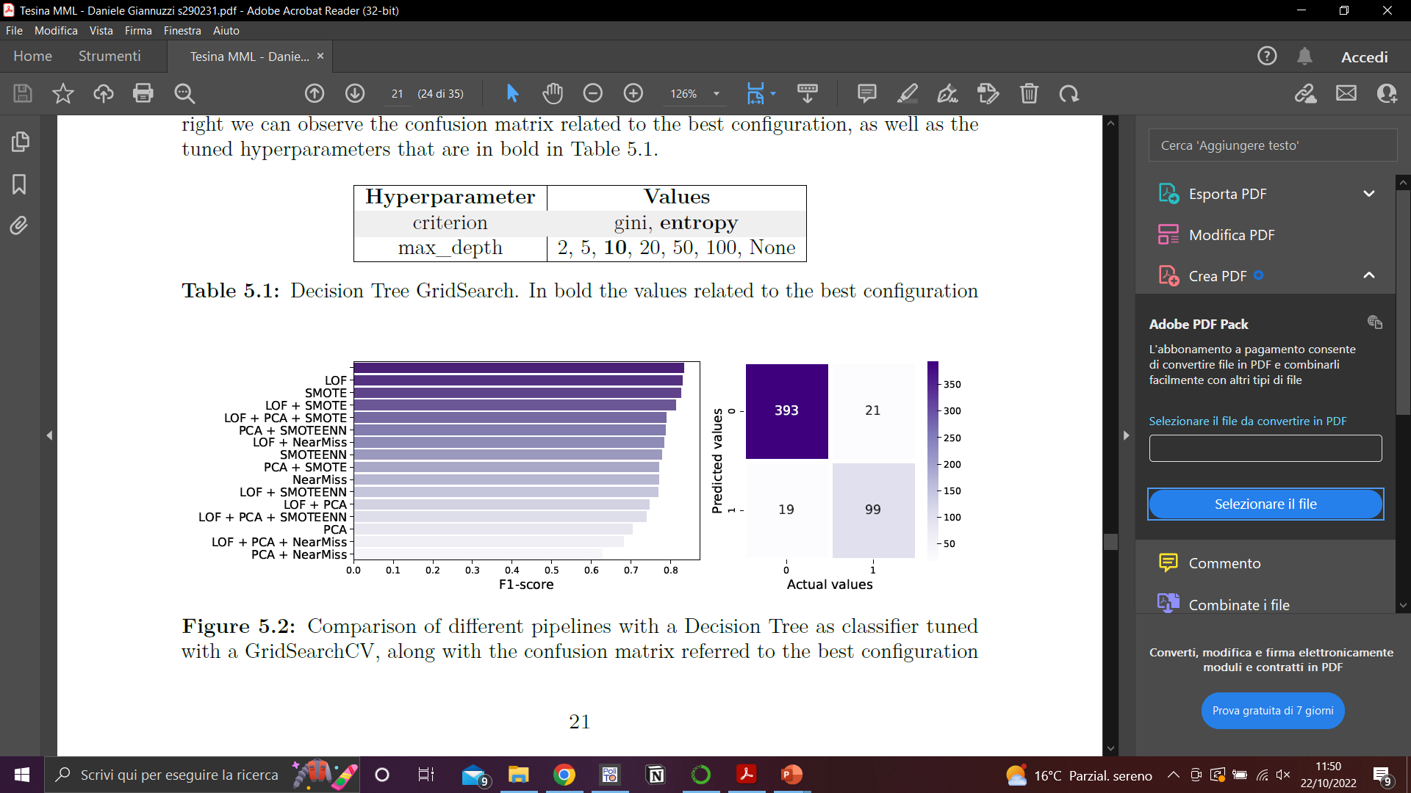
Evaluation: Decision Tree Pipeline

Slide 15

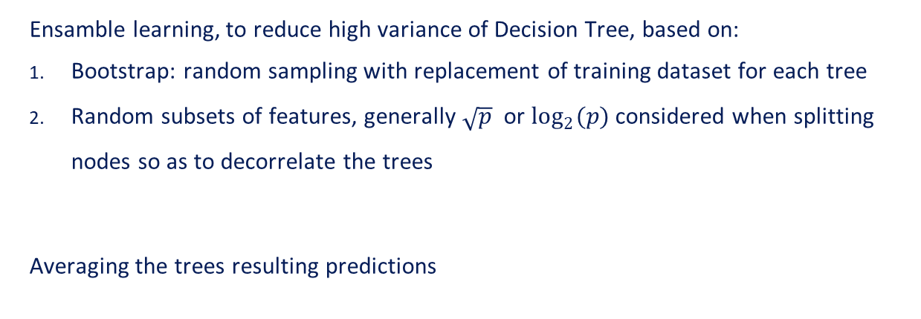
Model: Random Forest
Ensamble learning, to reduce high variance of Decision Tree, based on:
Bootstrap: random sampling with replacement of training dataset for each tree
Random subsets of features, generally $\sqrt{p}$ or $\log_{2}{(p)}$considered when splitting nodes so as to decorrelate the trees
Averaging the trees resulting predictions

Slide 16
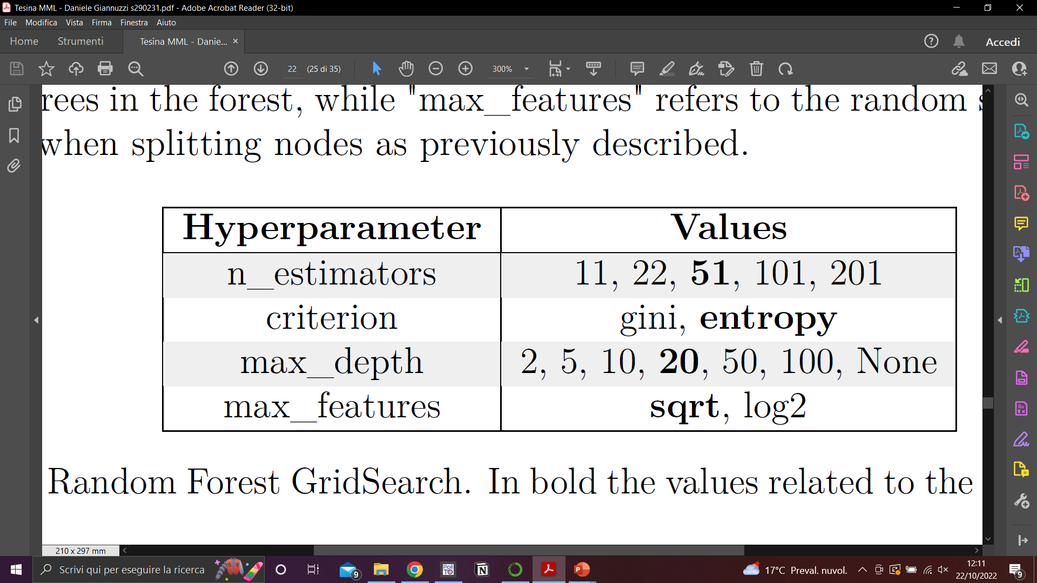
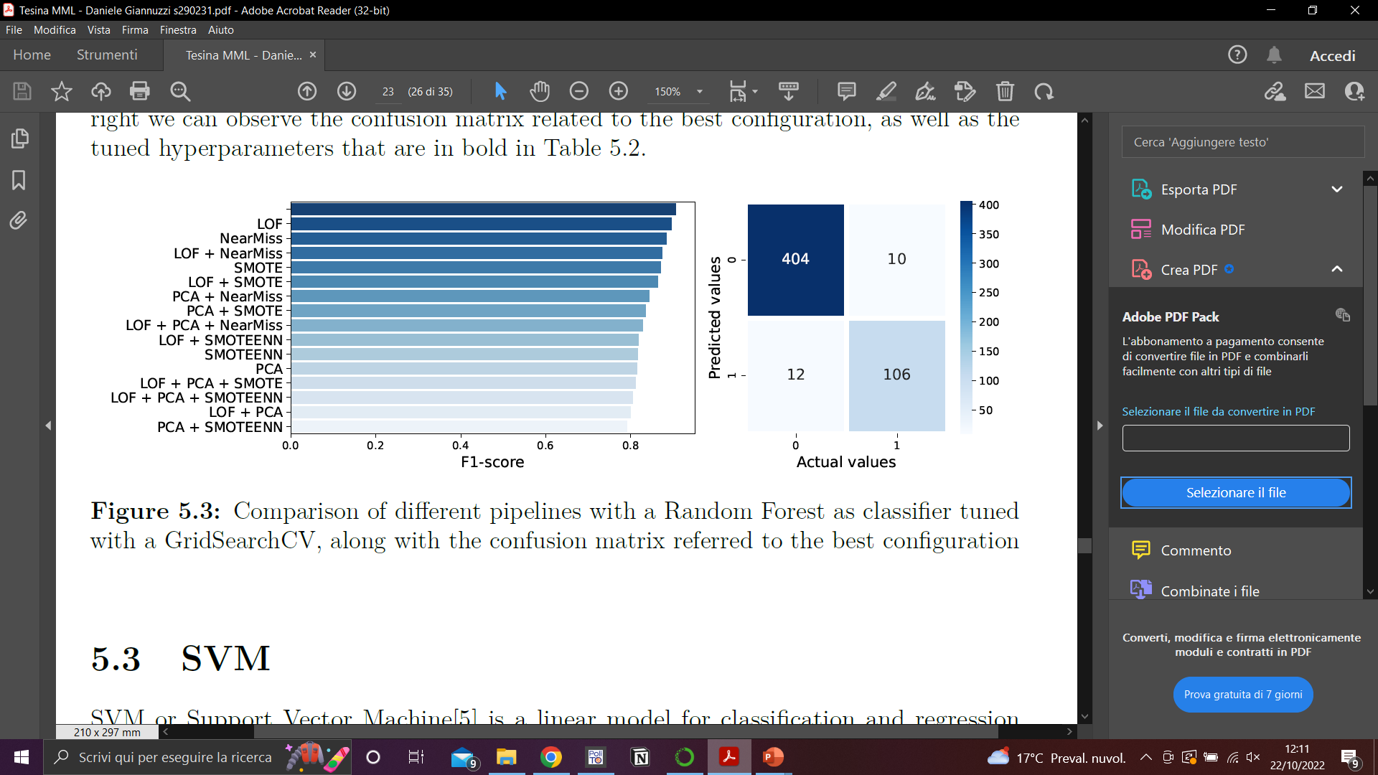
Evaluation: Random Forest pipeline

Slide 17
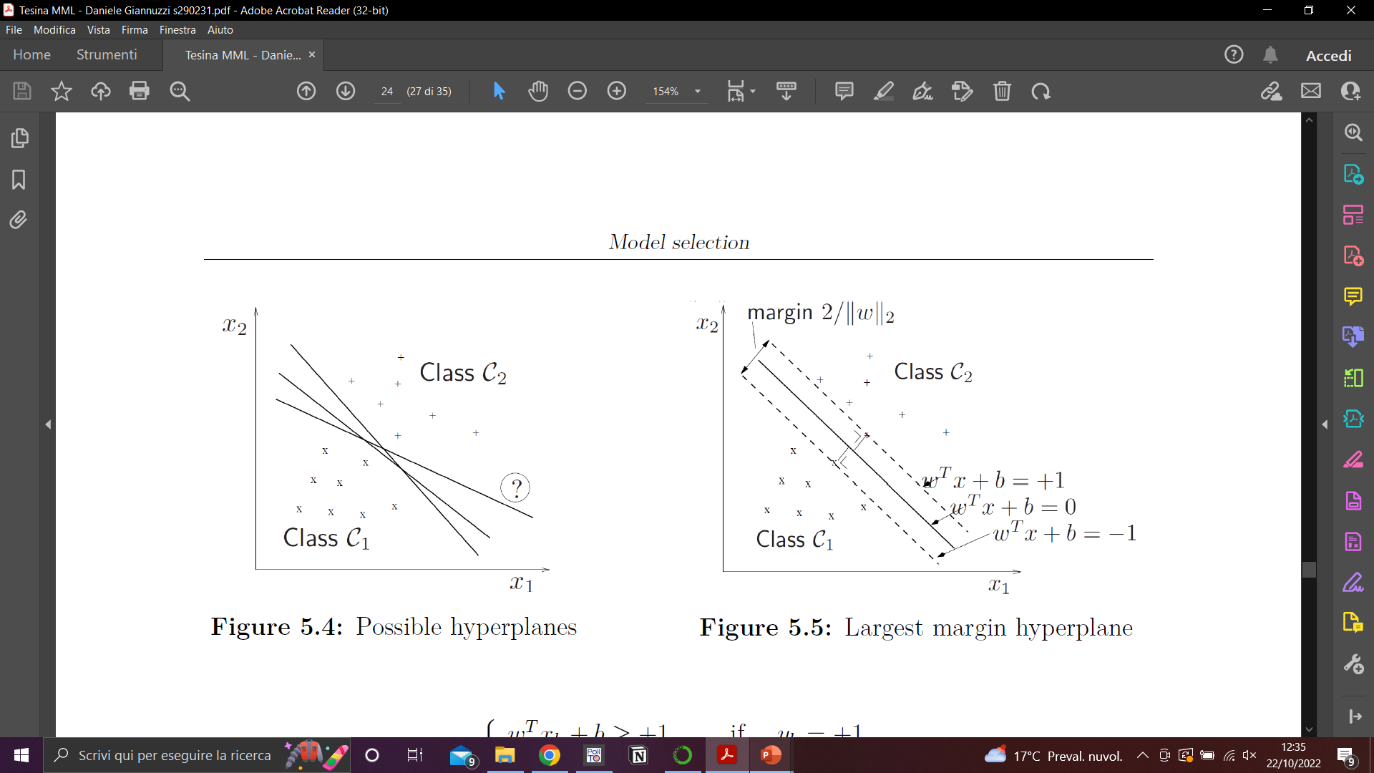
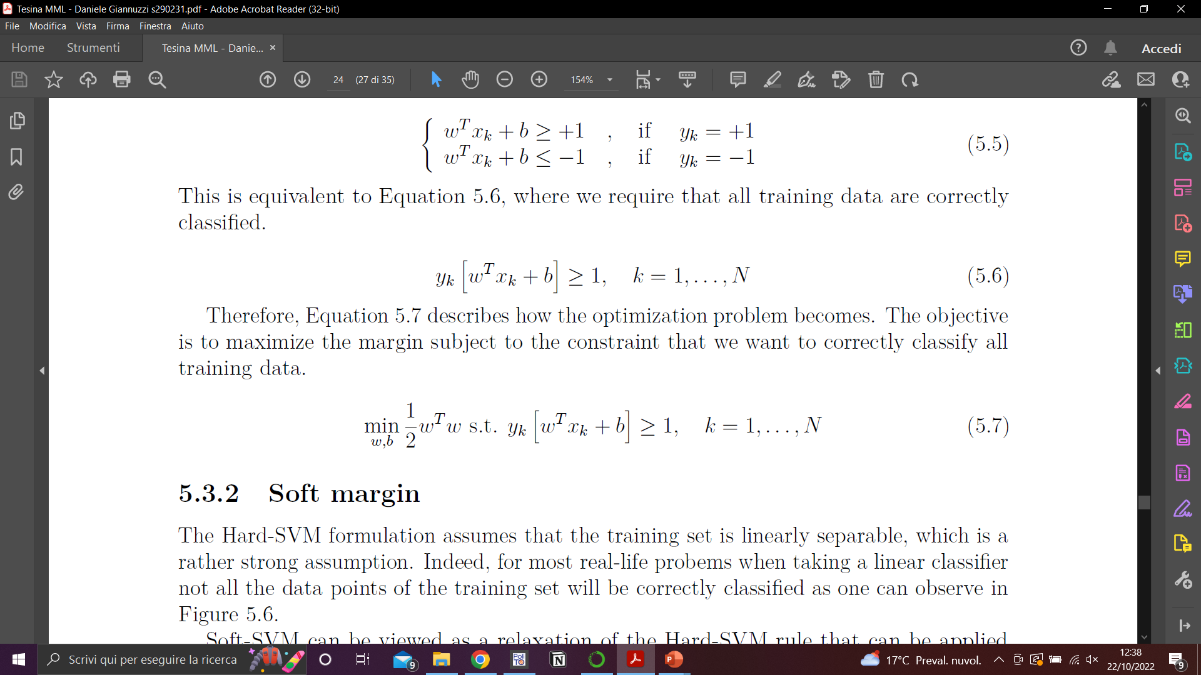
Model: SVM
Support Vector Machine: creates a hyperplane that separates the data into classes
Margin: minimal distance between a point in the training set and the hyperplane
Hard SVM: find a hyperplane with the largest possible margin
Optimization problem:

Slide 18
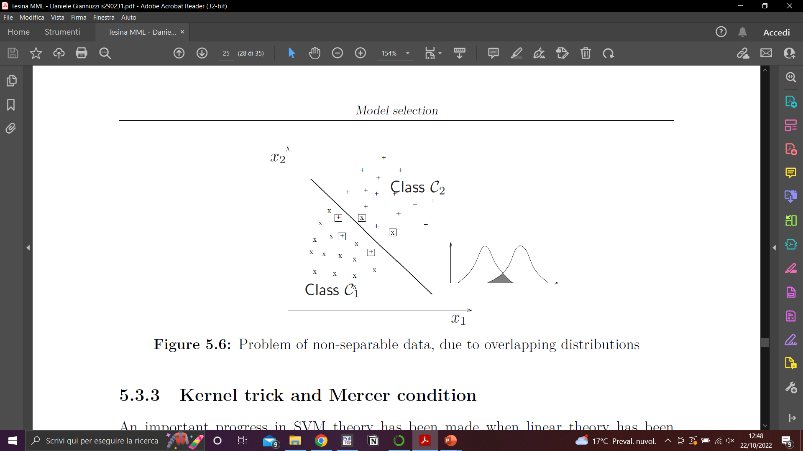
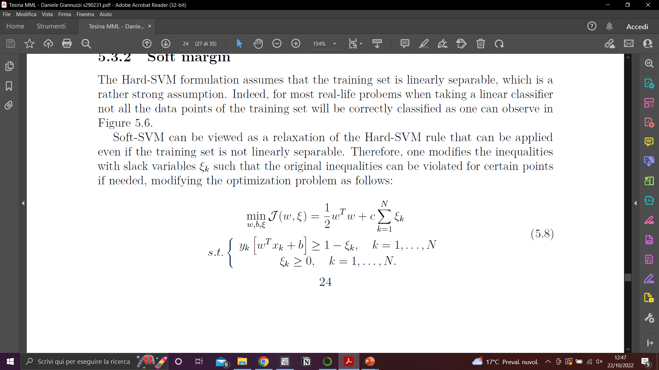
Model: SVM
Soft SVM: relaxes Hard SVM strong assumption that the training set is linearly separable
Introducing slack variables such that the original inequalities can be violated for certain points
Optimization problem:

Slide 19
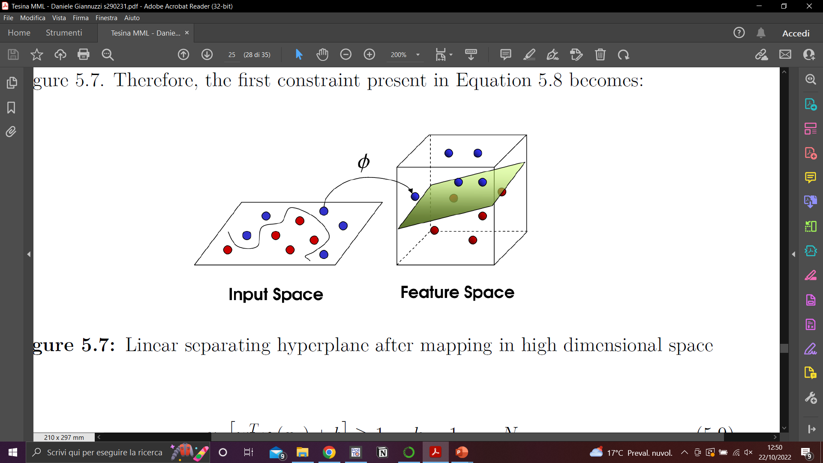
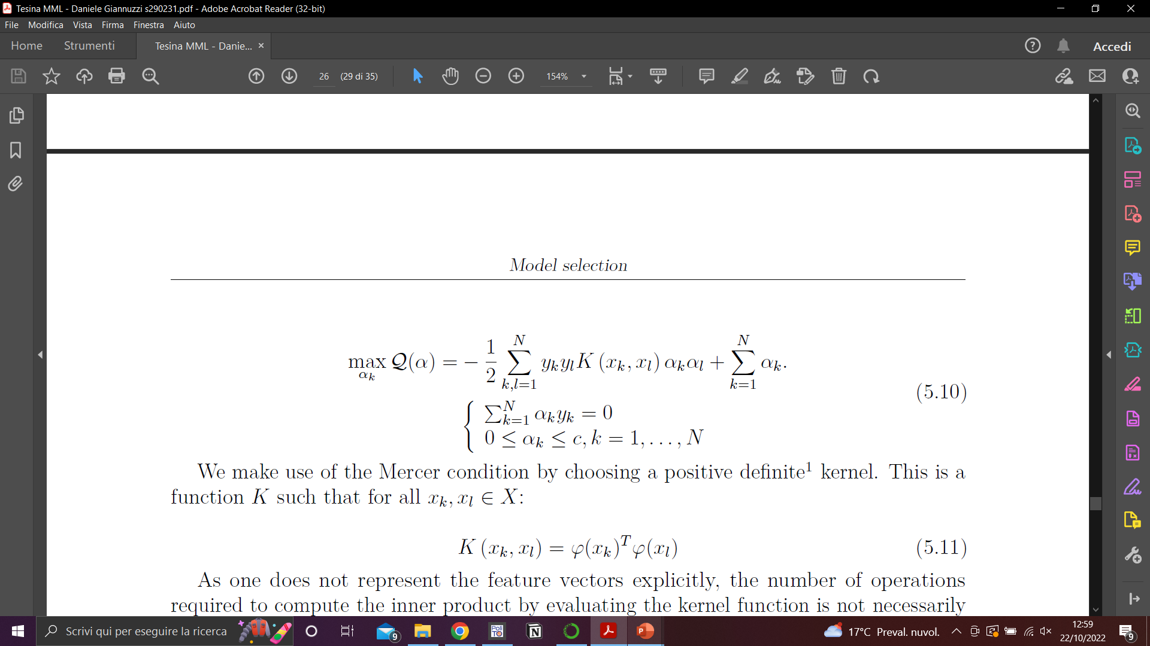
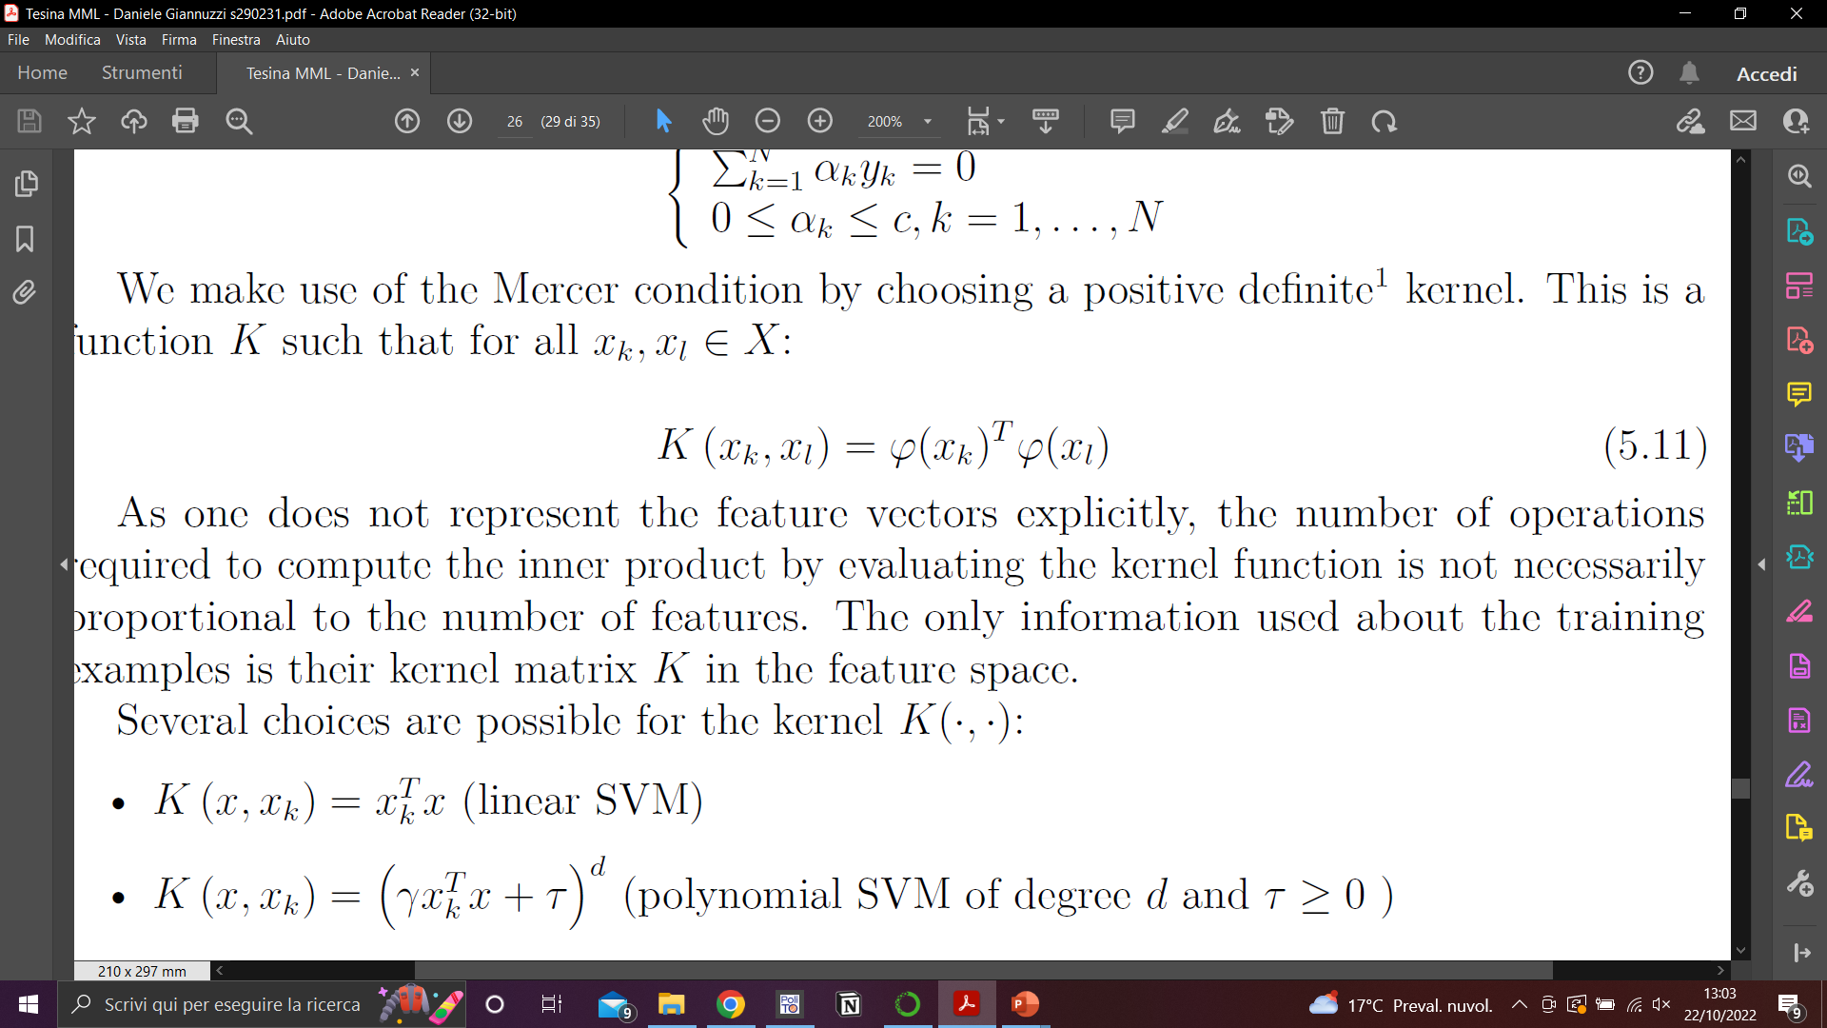
Model: SVM
To extend SVM theory to non-linear models
we further need a non-linear mapping of data into a
high dimensional feature space, finding there a linear separating hyperplane.
As a consequence of the dual representation
after solving with Lagrangian multipliers:
Mercer theorem: no need for explicit construction of nonlinear mappings,
by using a positive semi-definite kernel function K, such that for all

Slide 20
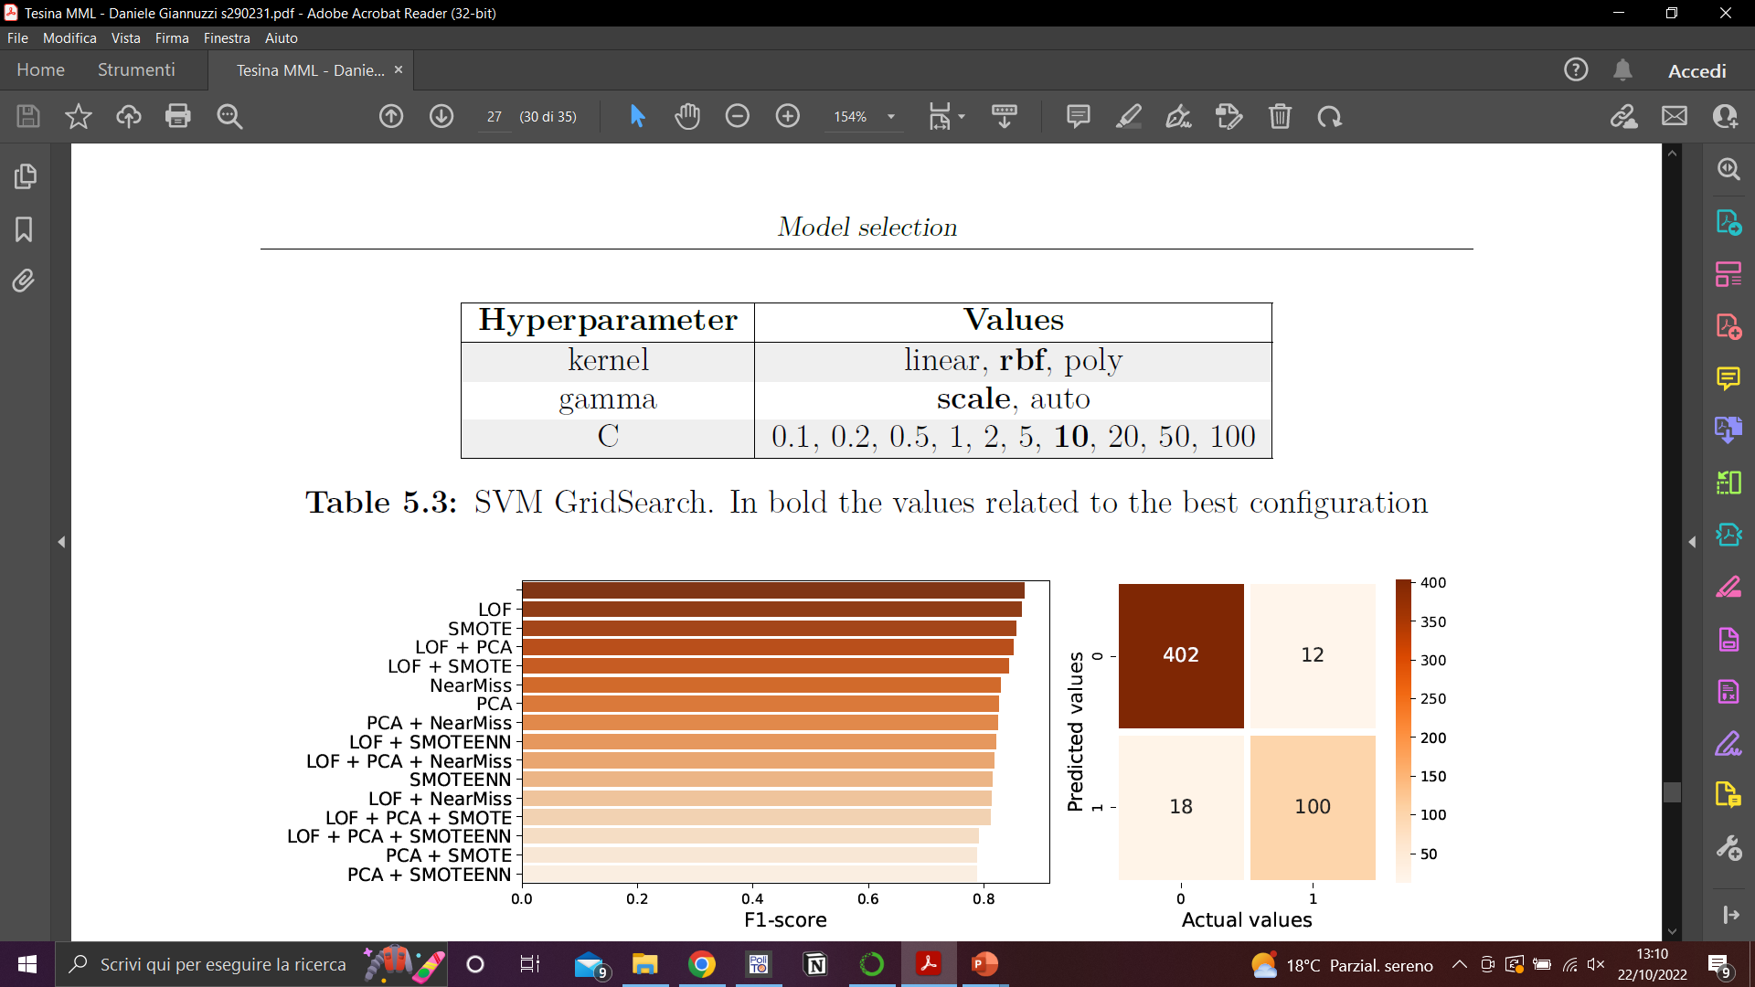
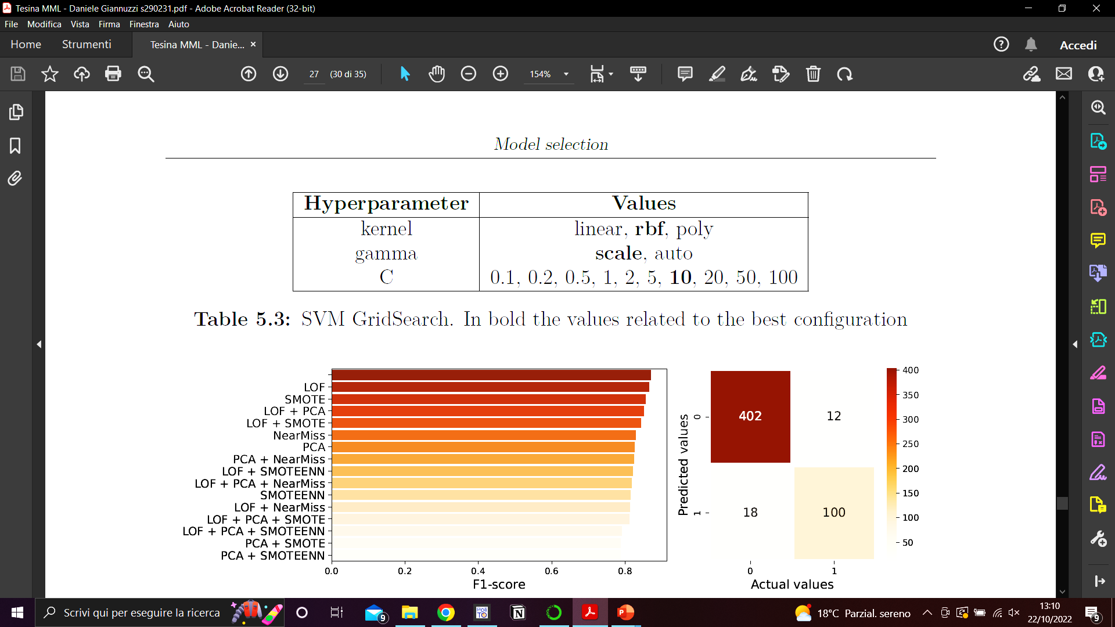
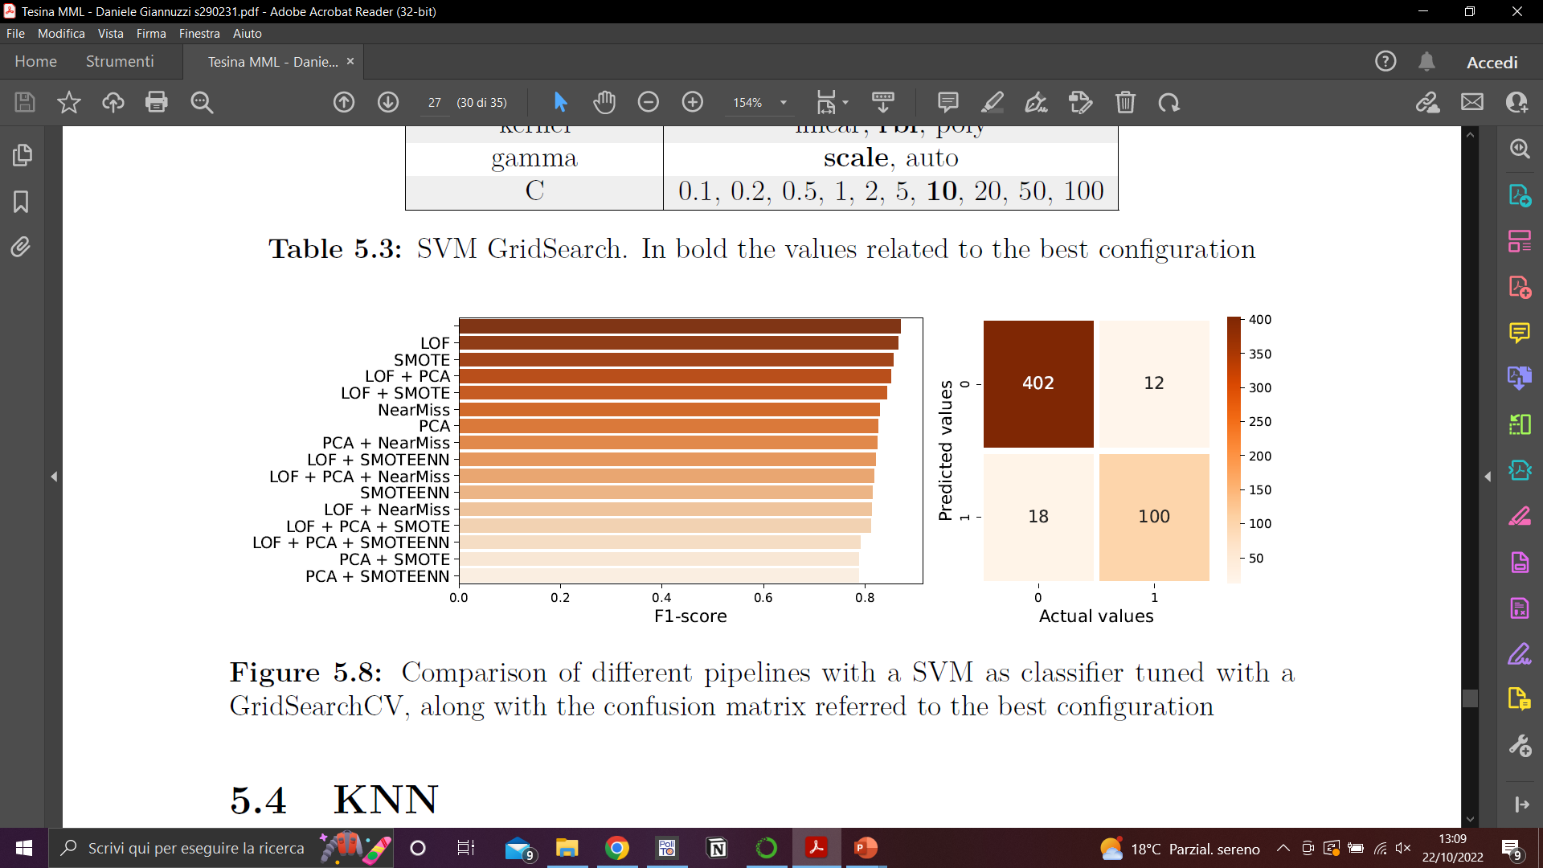
Evaluation: SVM

Slide 21
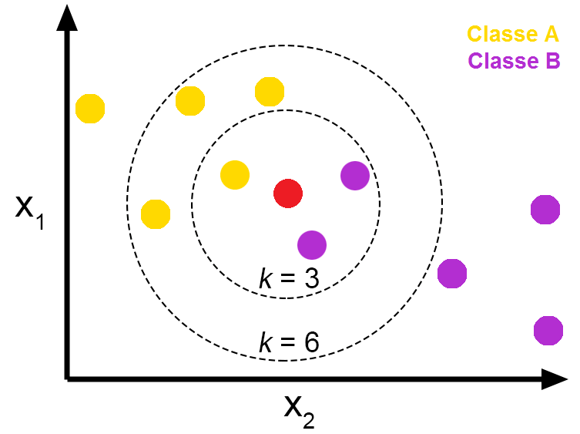
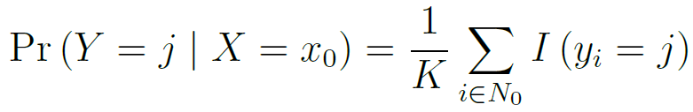
Model: KNN
Predict the label of a new test point based on the labels of its K-closest neighbors in the training set
Given: K, a distance metric, and a test observation x₀
Do: identify the neighborhood N₀ made of K points and assign x₀ to the class with the highest estimated probability:

Slide 22
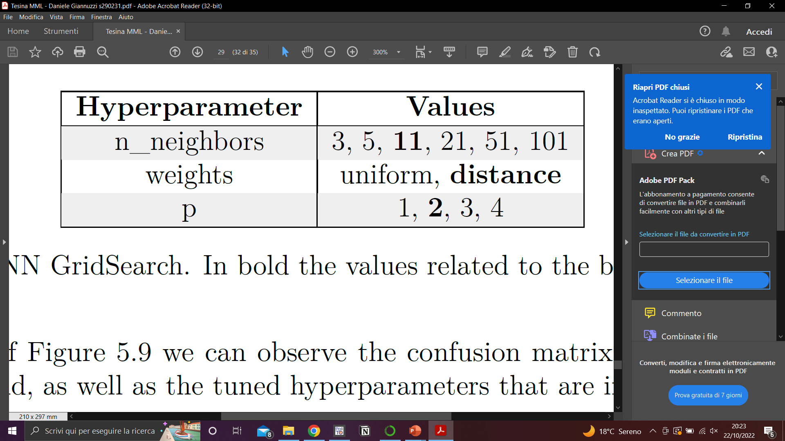
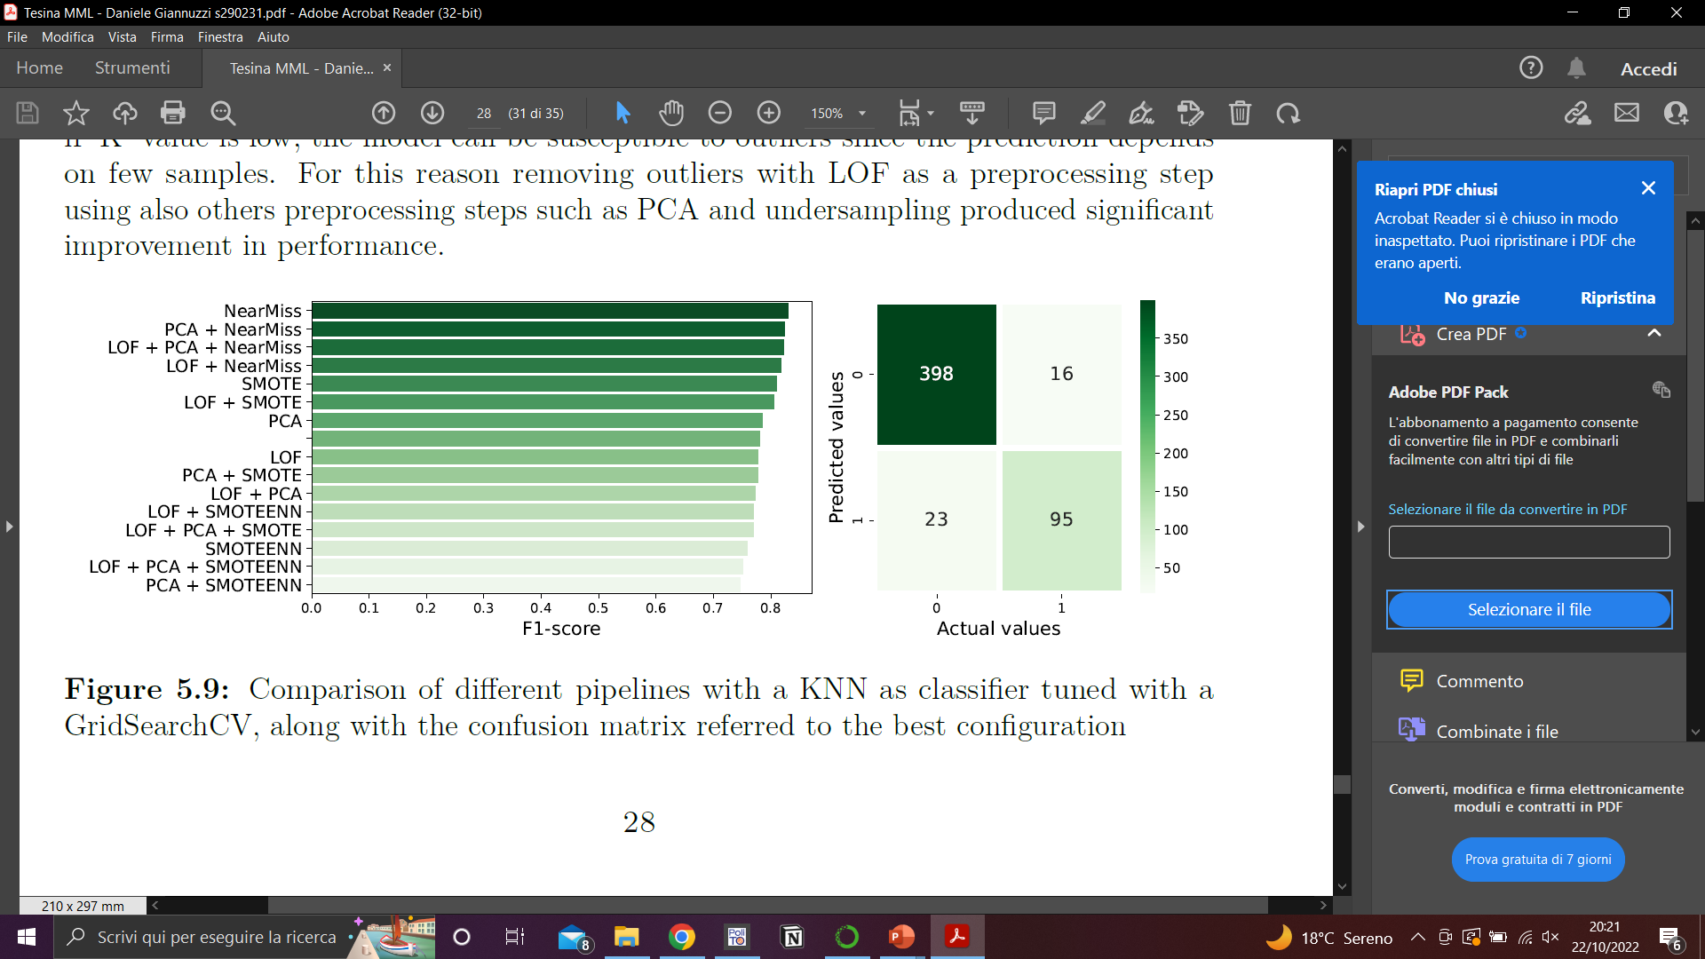
Evaluation: KNN

Slide 23
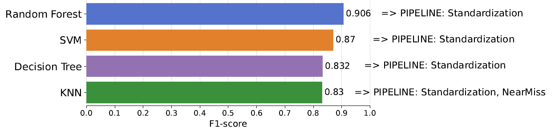
Comparison of different models
Random Forest pipeline outperforms the others on the F1-score evaluation

Slide 24
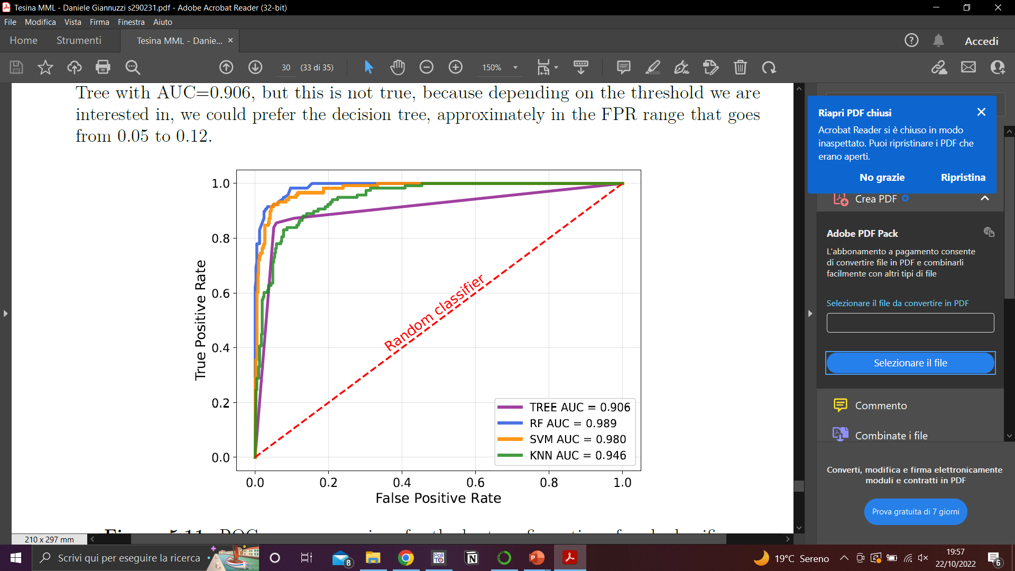
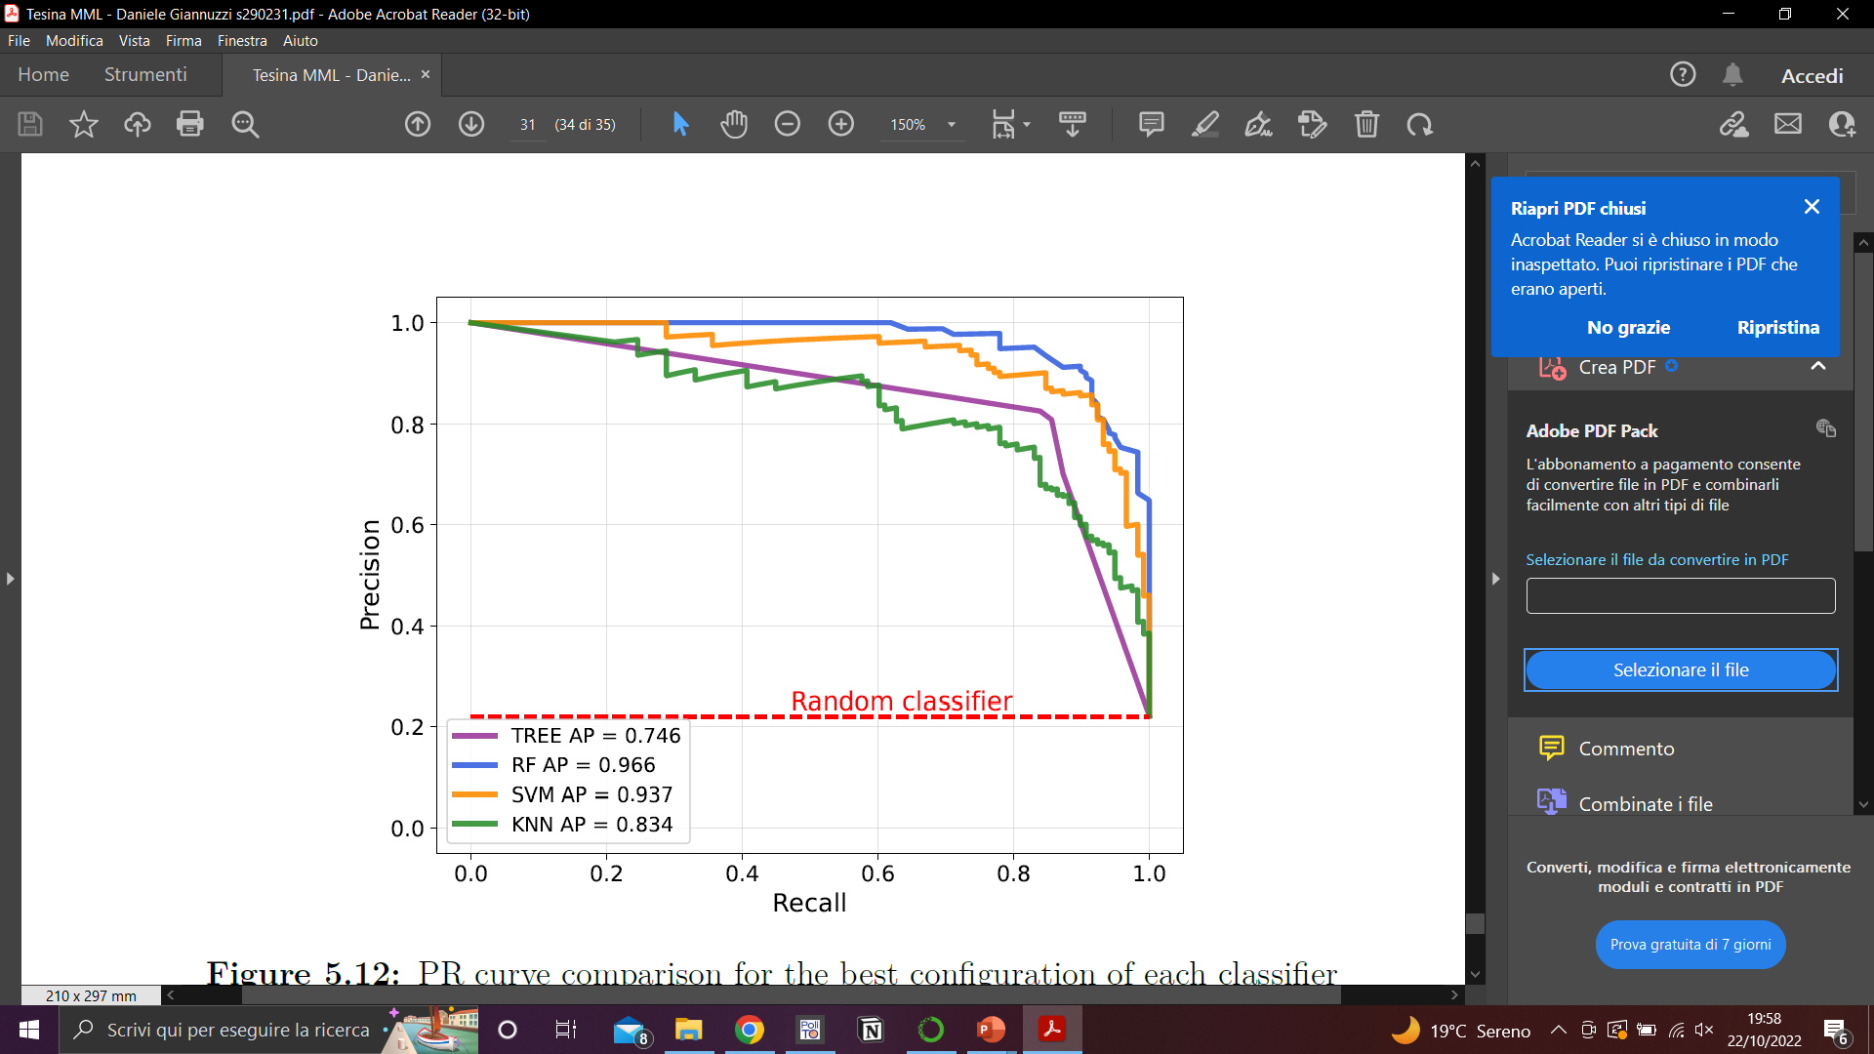
Comparison of different models

